Slide 1
Chess Game
Next

Slide 2
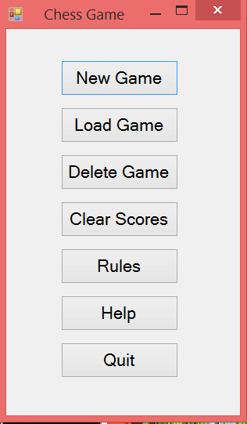
Click Here to start a new game

Slide 3
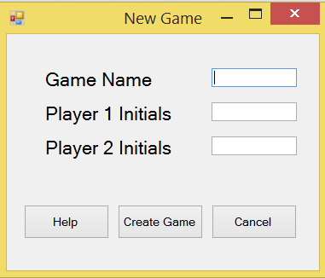
Click to fill in some details

Slide 4
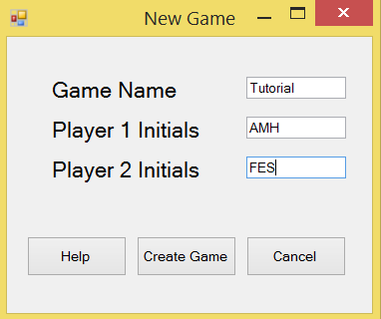
Now Create the new game

Slide 5
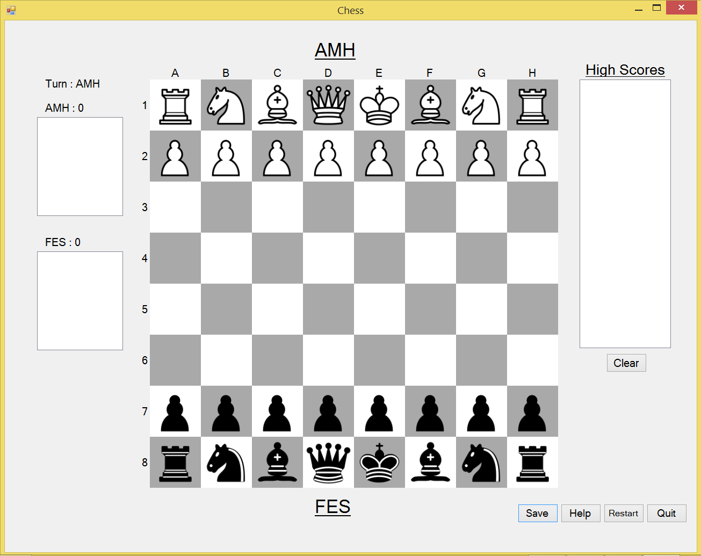
Try making a move

Slide 6
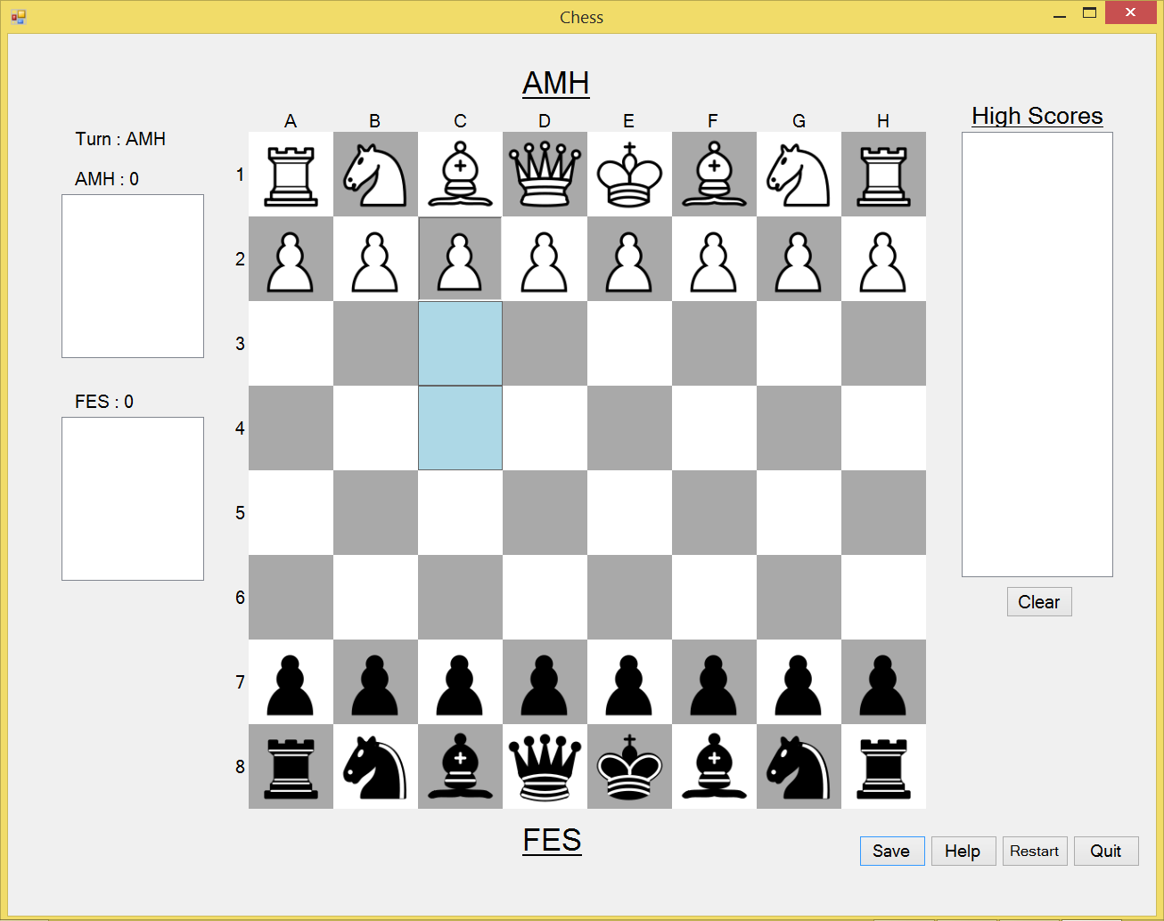
Click to move here

Slide 7
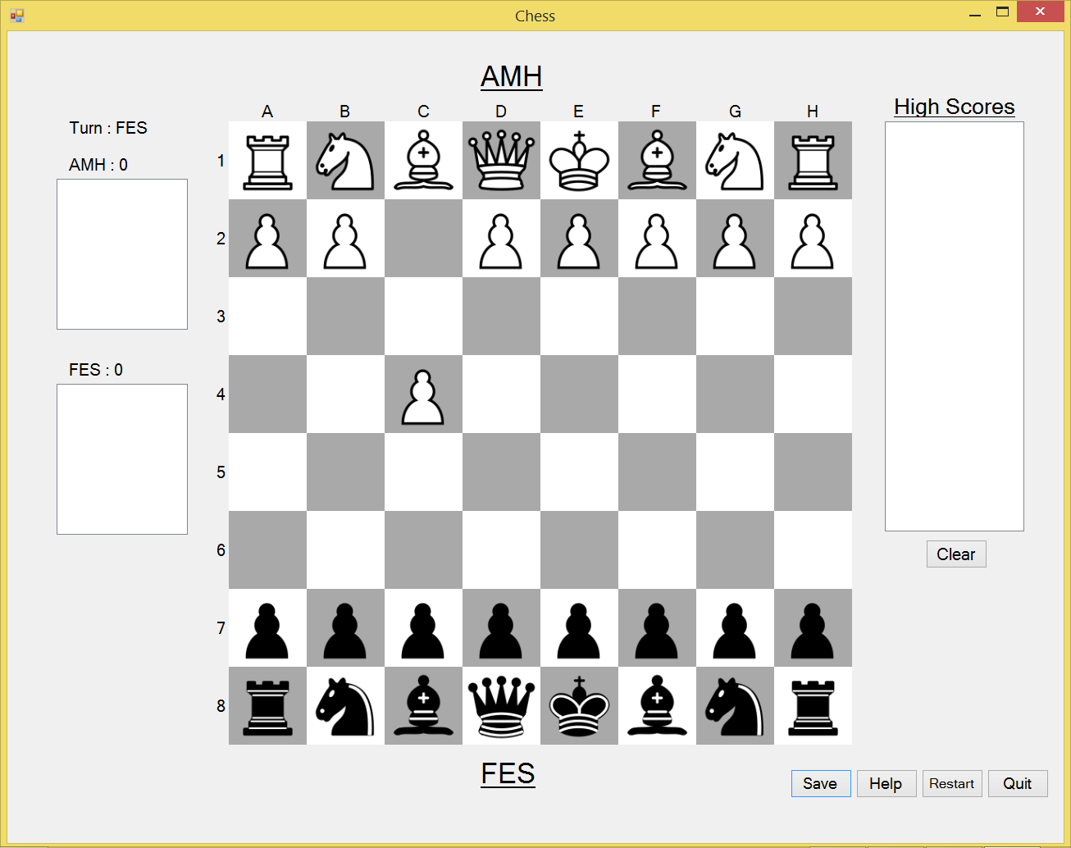
Lets save the game

Slide 8
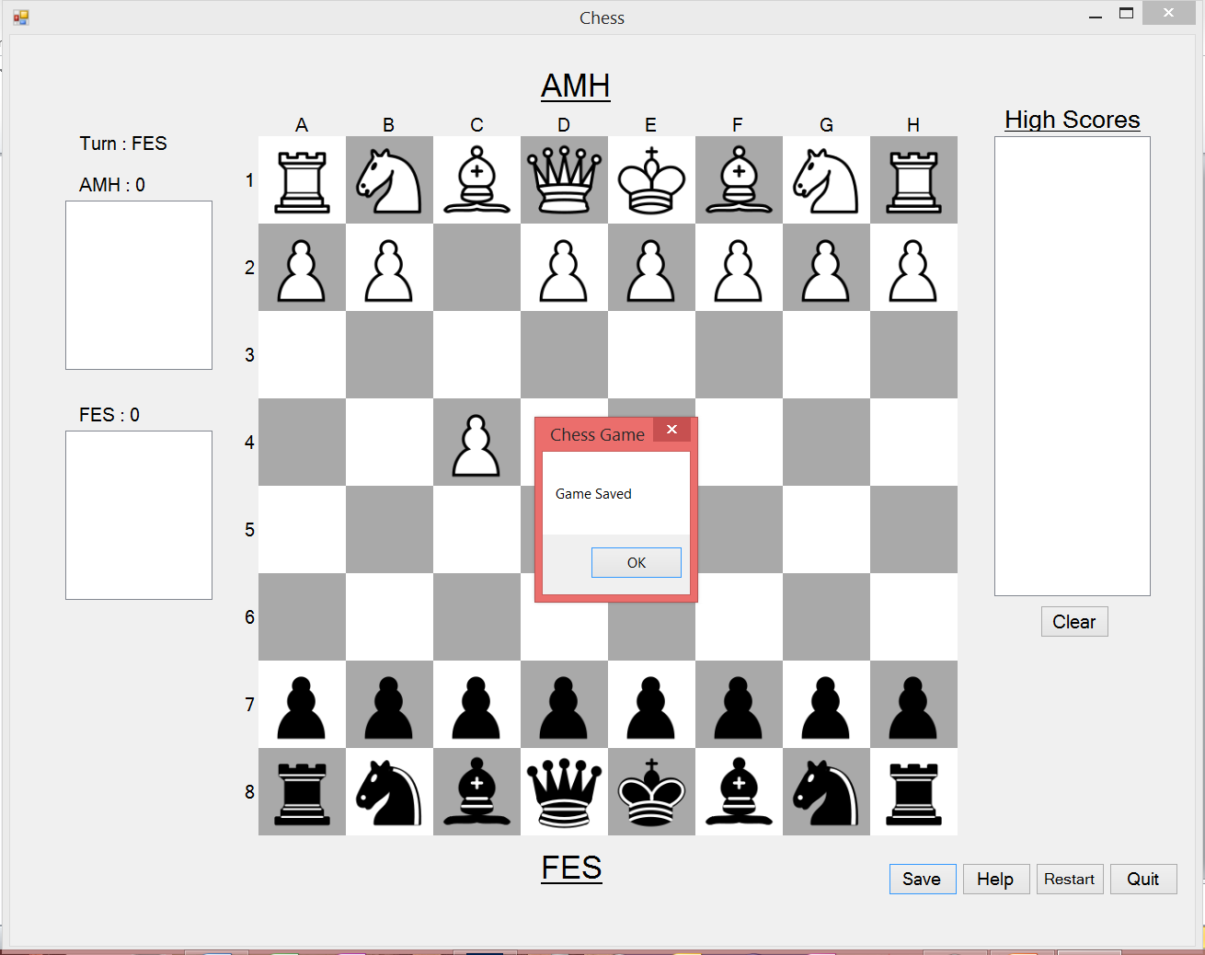
Click here to continue

Slide 9
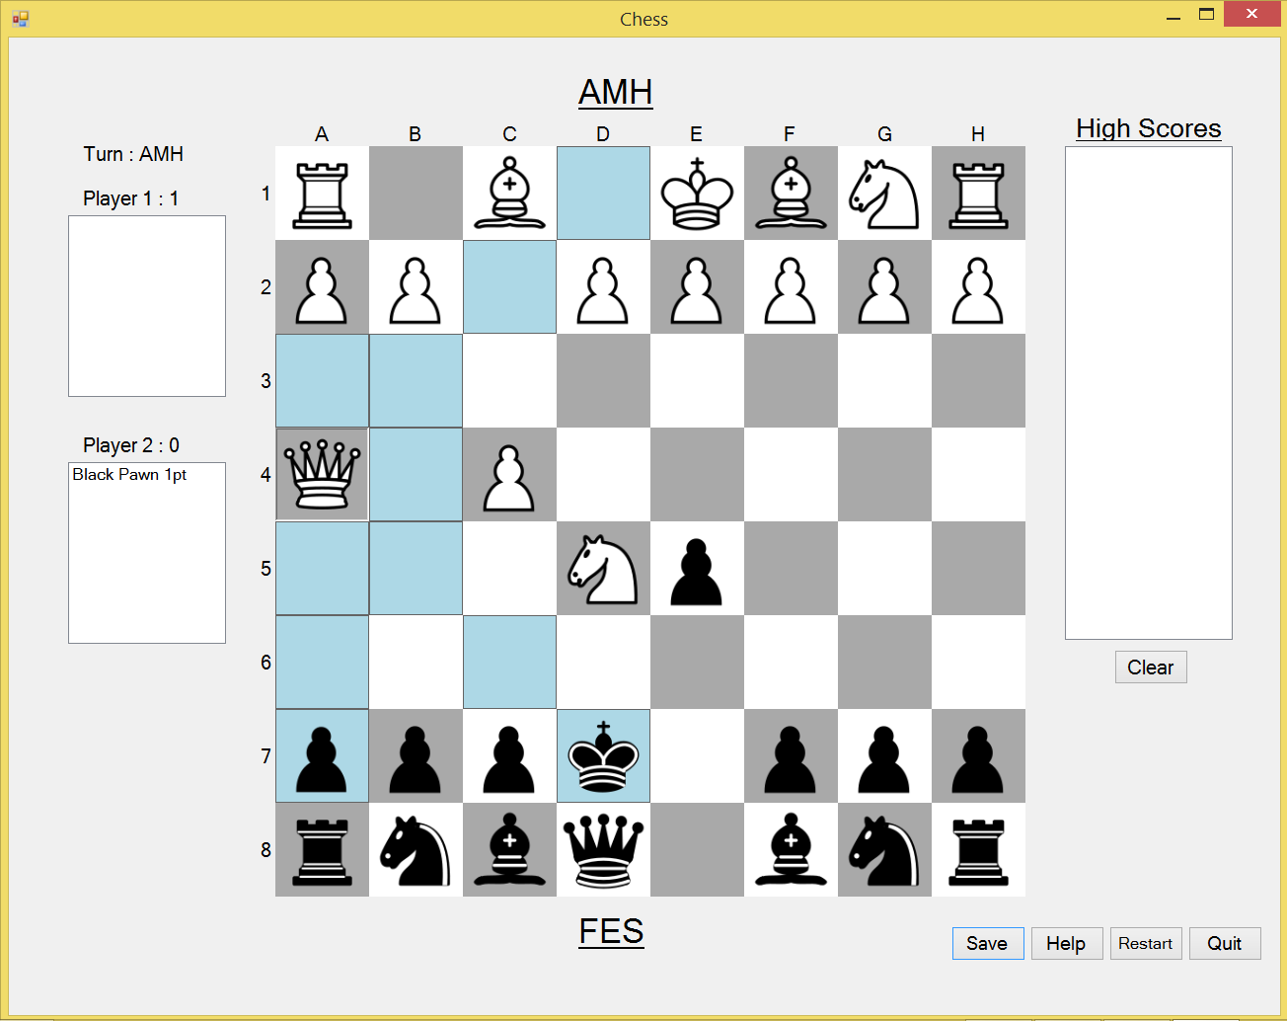
You can finish your opponent!

Slide 10
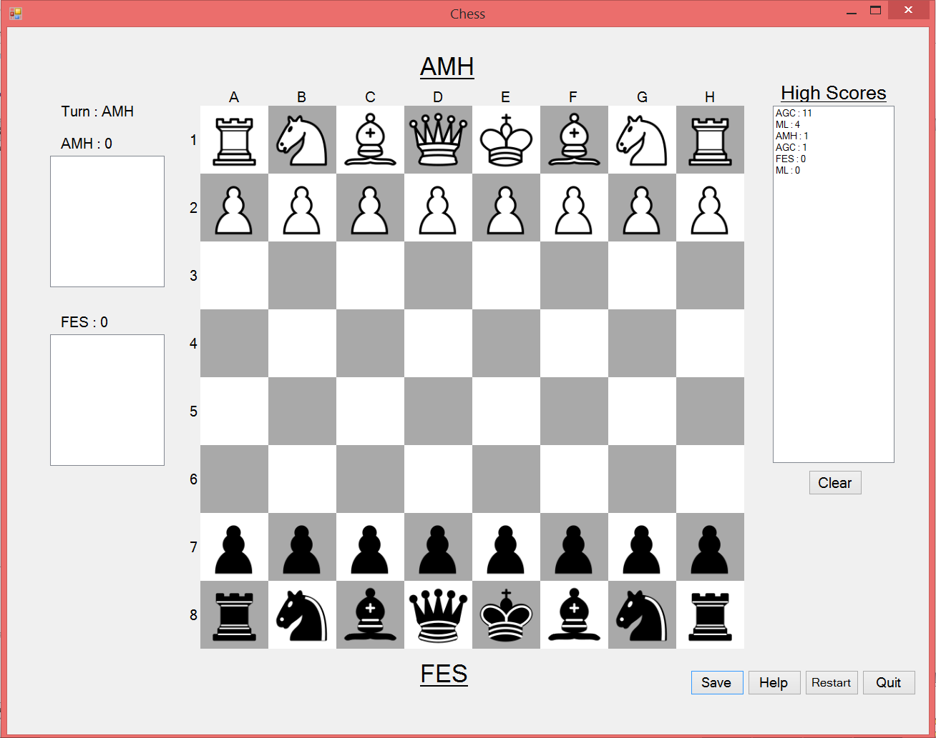
You can see the updated scores list
Click to end the tutorial

Slide 11
The End
Restart

